Slide 1

Predicting income threshold from US census
By Adam Cooper

Slide 2
Objective
Mission Statement: Using the United States Income Census data from 2010, can we determine characteristics associated with whether an individual earns below a threshold of $50,000 in a year.
This can be seen as a binary determination, does an individual earn less than $50,000 (1) or not (0)
Data contains a wealth of categorical and numerical information about individuals, including ages, marital status, job occupation, gender, race
We can leverage a range of machine learning solutions to find an issue to this problem
Development of model pipeline could be extended out to other countries and could have wide reaching benefits as a product

Slide 3
Exploratory data analysis
~300,000 data points split into testing (33%) and training set (66%)
Our target variable is the income bound field, with a split of 183,912 earning less than $50,000 and 12,382 earning over $50,000 in our training data set
Total of 41 potential fields to train model on, with 8 numerical and 33 categorical
Examined distributions of numerical data, many heavily weighted towards 0, especially fields relating to wages and capital
The key reason for this is due to a large number of under 18s present in data, who either haven’t worked yet or just starting their careers

Slide 4
Data preparation & feature generation
Tackled missing values: substituted ‘Unknown’ for categorical variables, removed completely columns with at least 70% missing values, removed rows for subset of values where missing data <5%
Removed columns in hierarchy with lower granularity
Encoded categorical variables so that they could be ingested by the models
Generated the following variables:
Capital net gains = Capital gains – Capital Losses
Education cleaned: Grouped children that hadn’t graduated as a category as well as adults with no qualifications
Marital status cleaned: Grouped the various subcategories of ‘Married’ into a single bin
Removed features with high correlation as won’t bring any new information and reduces complexity

Slide 5
Classification model selection
Interpreted the task as a binary classification problem, either an individual is earning less than $50,000 or not
Tested four different binary classification models: K-Nearest Neighbours, Decision Trees, Random Forest and Gradient-Boosted Trees
These types of models all work well with a mix of data types as inputs
All had high accuracy (~90-95%) due to nature of the imbalanced data set
Ultimately decided on GBT classifier as it was the best option for handling data balance, despite not being the best performing solution

Slide 6
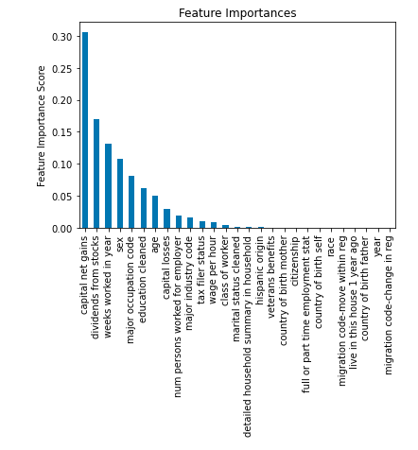
Key features
Extracted key features from my baseline model through feature importance setting a variance threshold of 0.025 (red line)
Leaves us with 8 input variables for optimised model and removing the noise of the other features that have little impact on our predictor
Most important feature is the capital net gains field I generated
Important to do this to reduce model complexity and improve interpretability of results

Slide 7
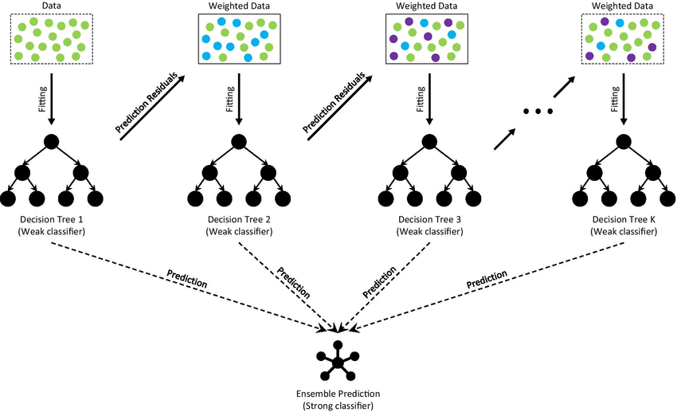
Model optimisation
Used a parameter grid search for the GBT model with our updated set of features to determine optimum parameter combination for best results
We do this through parsing a range of values for each parameter and testing all combinations to see which provides the best model performance
This is important to do to ensure we are getting the most out of our chosen model and achieving the best metrics
Best Parameters
N Estimators (250): # boosting stages to perform
Max Depth (4): Maximum # estimator levels
Learning Rate (0.1): Controls the speed at which the model learns at each step

Slide 8
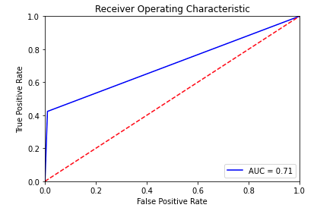
Evaluation and results
Accuracy: 95.5%
Precision: 0.744
Recall: 0.423
AUC: 0.707
 | Positive Prediction | Negative Prediction
$50,000- | 87,610 | 846
$50,000+ | 3,353 | 2,460

Slide 9
Challenges and limitations
The ROC curve is skewed at a harsh angle near zero due to a low recall, if we were to train a much more balanced data set we could see performance issues
A number of fields had a lot of data quality issues and missing values
Lots of noise in categorical data with too many similar options (such as Detailed household and family stat with 38 unique values)
GBT classifiers are limited in scalability and prone to overfitting so may not be a viable model to expand out to a much larger dataset
Children heavily weighing the data towards less than $50,000 income ( only 3 have an income higher than 50k)

Slide 10
Conclusion & next steps
More work still to be done to improve $50,000+ predictions
Tackle data imbalance directly through stratified sampling techniques and go back to better performing classification models
Incorporate more data binning on discrete variables, such as age
Identify opportunities for external data sources, for example state average incomes, retirement ages
Explore some alternative ML models, treating $50,000+ cases as anomalies in an anomaly detection model could be useful tool
Could also explore deep learning models such as convolution neural networks

Slide 11
Thank You!
Do you have any questions?

